Slide 1
Superstore Sales Performance Dashboard
Data Visualization & Business Insights | AnalystLab Africa — Week 4
Gloria Okoli
June 2026

Slide 2
Dataset Overview
Source: Kaggle Superstore Sales Dataset
9,994 rows | 21 columns | 4 years of data (2014–2017)
Coverage: United States retail sales across 3 categories, 4 regions, 3 customer segments
Key fields: Order Date, Sales, Profit, Category, Region, Segment, Product Name

Slide 3
Business Problem
The Superstore needs to understand what is driving sales and profit across its regions and product categories
Key questions:
Which regions and categories are most profitable?
Which products are top performers?
When do sales peak during the year?
Which segments drive the most revenue?

Slide 4
Key Performance Indicators
💰 Total Sales — $2.30M in revenue across 4 years
📈 Total Profit — $286.40K overall profit generated
🛒 Total Orders — 9,994 orders processed
📊 Profit Margin — 12.47% average margin
🏆 Top Region — West region leads in sales
🥇 Top Category — Technology at 36.4% of sales

Slide 5
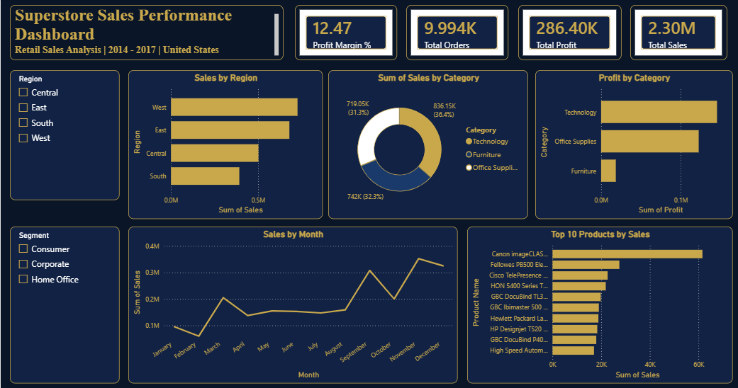
Interactive Dashboard Built in Microsoft Power BI | Interactive slicers by Region & Segment

Slide 6
Key Insights
West region generates the highest sales at $500K
Technology is the most profitable category
Sales peak sharply in November–December each year
Canon imageCLASS is the single best-selling product
Furniture has the lowest profit margin despite decent sales
Consumer segment drives the majority of orders

Slide 7
Recommendations
Invest more in the West region — it consistently outperforms all others
Expand Technology product lines — highest sales and profit margin
Launch targeted promotions in Q4 (October–December) to maximize peak season revenue
Review Furniture pricing strategy — sales volume is decent but profit margin is too low
Focus Corporate and Home Office segments — Consumer segment is saturated
Bundle slow-moving Office Supplies with top Technology products to boost cross-sales

Slide 8
Conclusion
This dashboard transforms 9,994 rows of raw retail data into clear, actionable business intelligence
Power BI enabled interactive exploration of sales trends, regional performance and product profitability
Key takeaway: The West region and Technology category are the primary growth drivers for the Superstore
Data-driven decision making is essential for sustainable retail performance
Tool used: Microsoft Power BI
Dataset: Kaggle Superstore Sales Dataset
Prepared by: Gloria Okoli | AnalystLab Africa — Week 4 | June 2026

